Slide 1
Estimating Individual Behaviour from Massive Social Data for An Urban Agent-Based Model
Nick Malleson & Mark Birkin
School of Geography, University
ESSA 2012

Slide 2
Outline
Research aim: develop a model of urban-dynamics, calibrated using novel crowd-sourced data.
Background:
Data for evaluating agent-based models
Crowd-sourced data
Data and study area: Twitter in Leeds
Establishing behaviour from tweets
Integrating with a model of urban dynamics

Slide 3
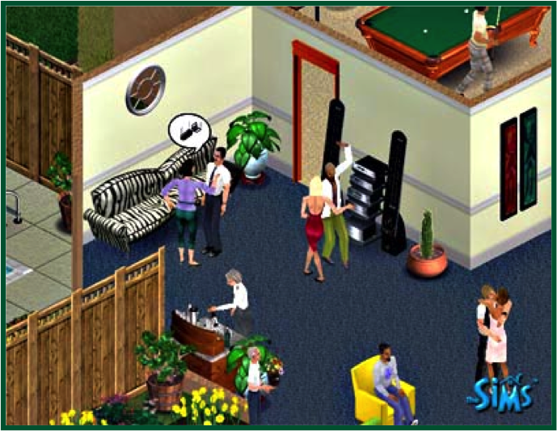
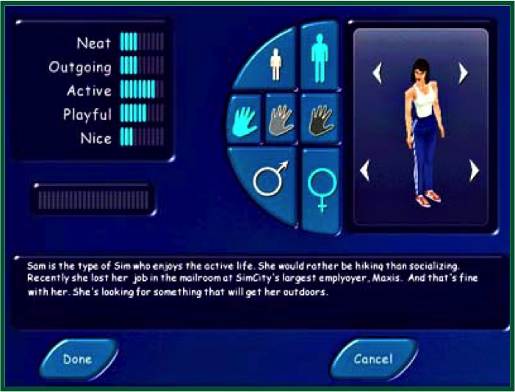
Agent-Based Modelling
Autonomous, interacting agents
Represent individuals or groups
Usually spatial
Model social phenomena from the ground-up
A natural way to describe systems
Ideal for social systems

Slide 4
Data in Agent-Based Models
Data required at every stage:
Understanding the system
Calibrating the model
Validating the model
But high-quality data are hard to come by
Many sources are too sparse, low spatial/temporal resolution
Censuses focus on attributes rather than behaviour and occur infrequently
Understanding social behaviour
How to estimate leisure times / locations?
Where to socialise?

Slide 5
Crowd-Sourced Data for Social Simulation
Movement towards use of massive data sets
Fourth paradigm data intensive research (Bell et al., 2009) in the physical sciences
“Crisis” in “empirical sociology” (Savage and Burrows, 2007)
New sources
Social media
Facebook, Twitter, Flikr, FourSquare, etc.
Volunteered geographical information (VGI: Goodchild, 2007)
OpenStreetMap
Commercial
Loyalty cards, Amazon customer database, Axciom
Potentially very useful for agent-based models
Calibration / validation
Evaluating models in situ (c.f. meteorology models)

Slide 6
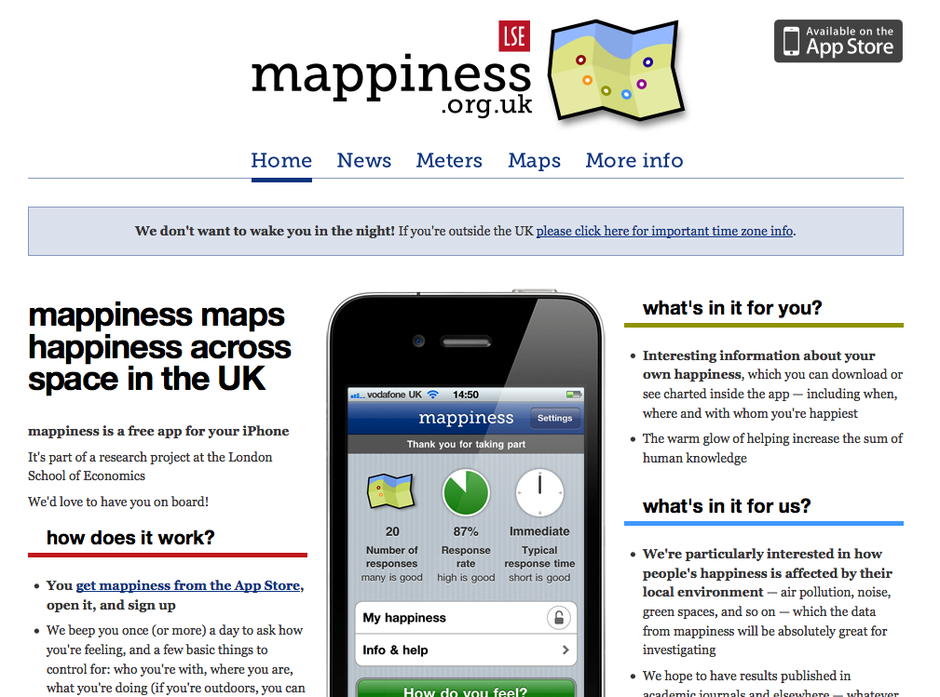
New Paradigms for Data Collection
(Successful) mobile apps to collect data
Offer something to users
New methodology for survey design (?)
E.g. mappiness
Ask people about happiness
Relate to environment, time, weather, etc.

Slide 7
Data and Study Area
Data from Twitter
Restricted to those with GPS coordinates near Leeds
‘Streaming API’ provides real-time access to tweets
Filtered non-people and those with < 50 tweets
Before Filtering
2.4M+ geo-located tweets (June 2011 – Sept 2012).
60,000+ individual users
Highly skewed: 10% from 32 most prolific users
After Filtering
2.1M+ tweets
7,500 individual users
Similar skew (10% from 28 users)

Slide 8
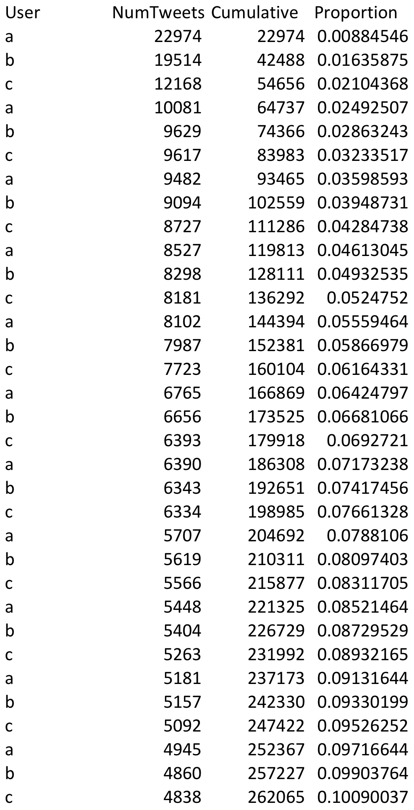
Prolific Users

Slide 9
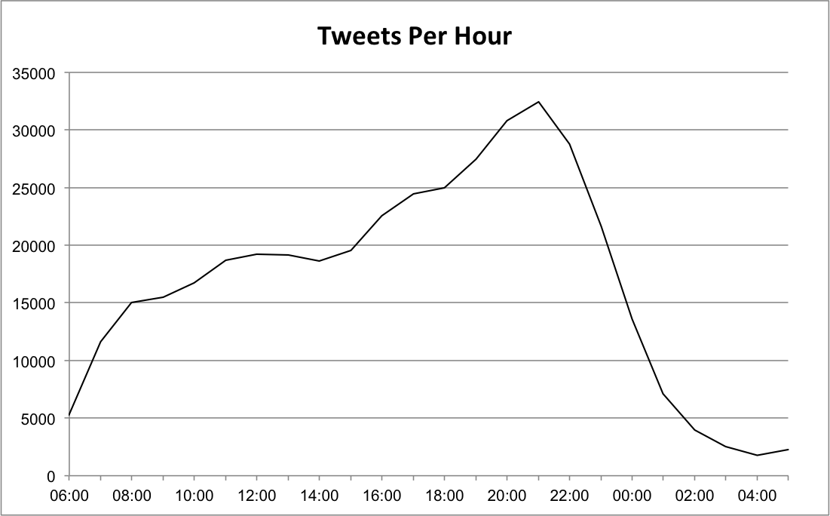
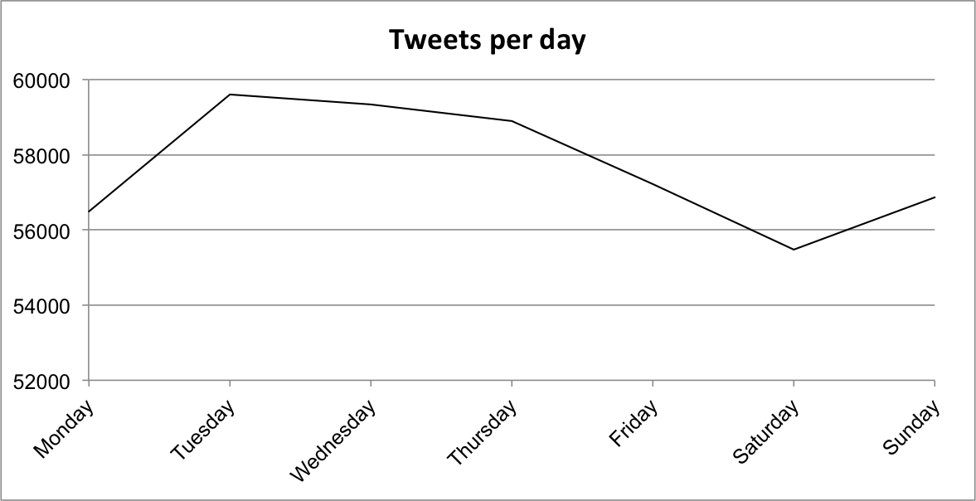
Temporal Trends
Hourly peak in activity at 10pm
Daily peak on Tuesday - Thursday
General increase in activity over time
Old data…

Slide 10
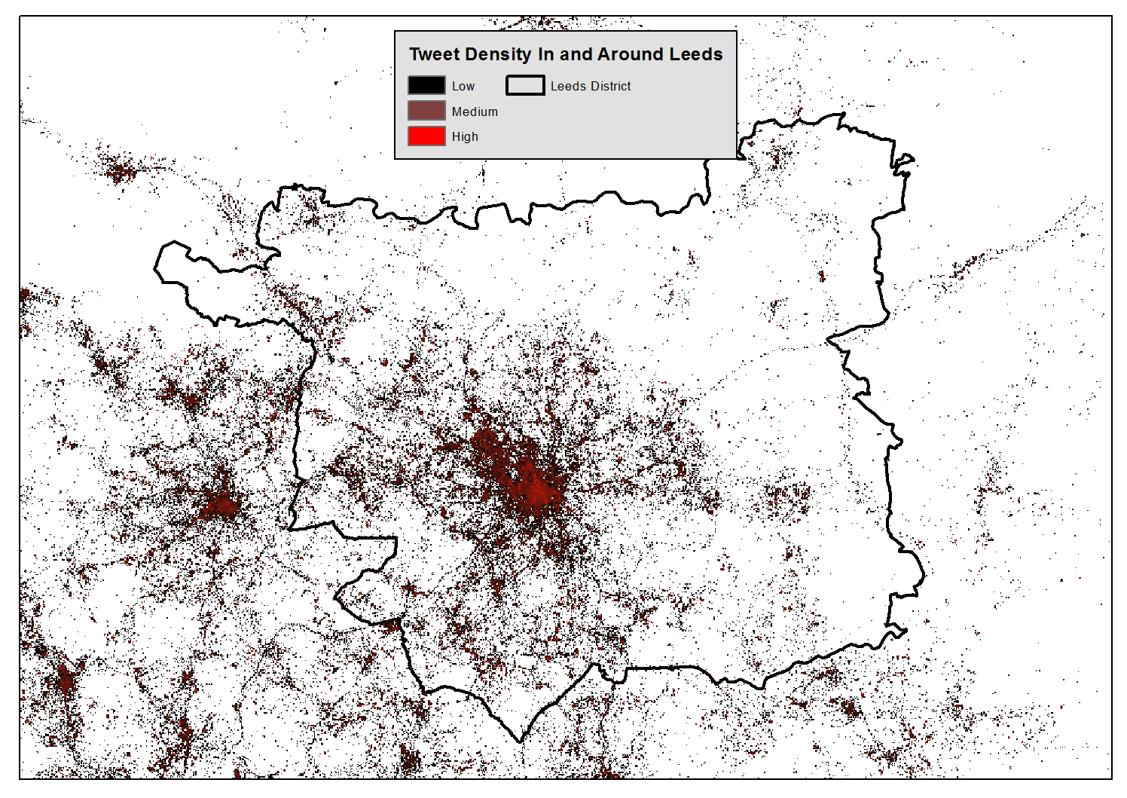
Notes:
Point density appears to cluster around urban centres.
Also able to distinguish roads in non-urban areas
General pattern somewhat distorted by locations of prolific users

Slide 11
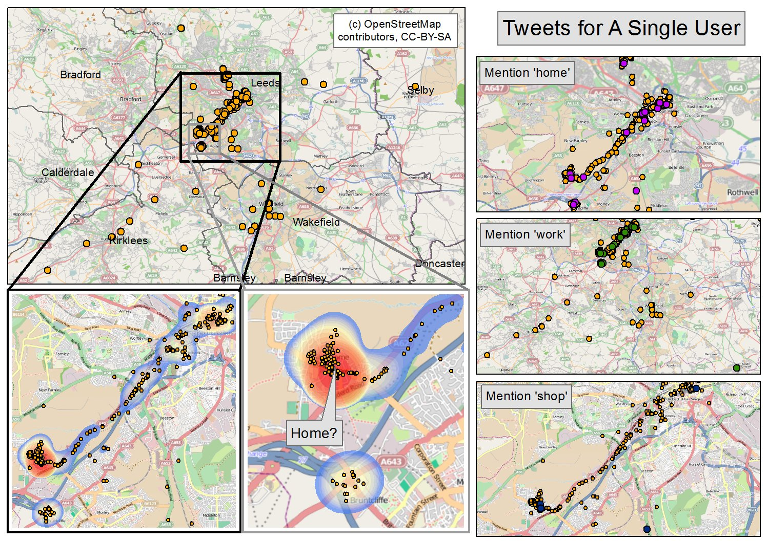
Identifying actions
Need to estimate what people are doing when they tweet (the ‘key’ behaviours)
Analyse tweet text
Automatic routine
Keyword search for: ‘home’, ‘shop’, ‘work’
‘Home’ appears to be the area with the highest tweet density
Unfortunately even tweets that match key words are most dense around the home

Slide 12
Spatio-temporal text mining
Individual tweets show why keyword search fails:
Work: “Does anyone fancy going to work for me? Don’t want to get up”
Home: “Pizza ordered ready for ones arrival home”
Shop: “Ah the good old sight of The White Rose shopping centre. Means I’m nearly home”
But still potential to estimate activity.
E.g. “I’m nearly home”
Combination of spatial and textual analysis is required
Parallels in text mining (e.g. NaCTeM) and other fields (e.g. crime modus operandi or The Guardian analysis of recent British riots)
New research direction: “Spatial text mining” ?

Slide 13
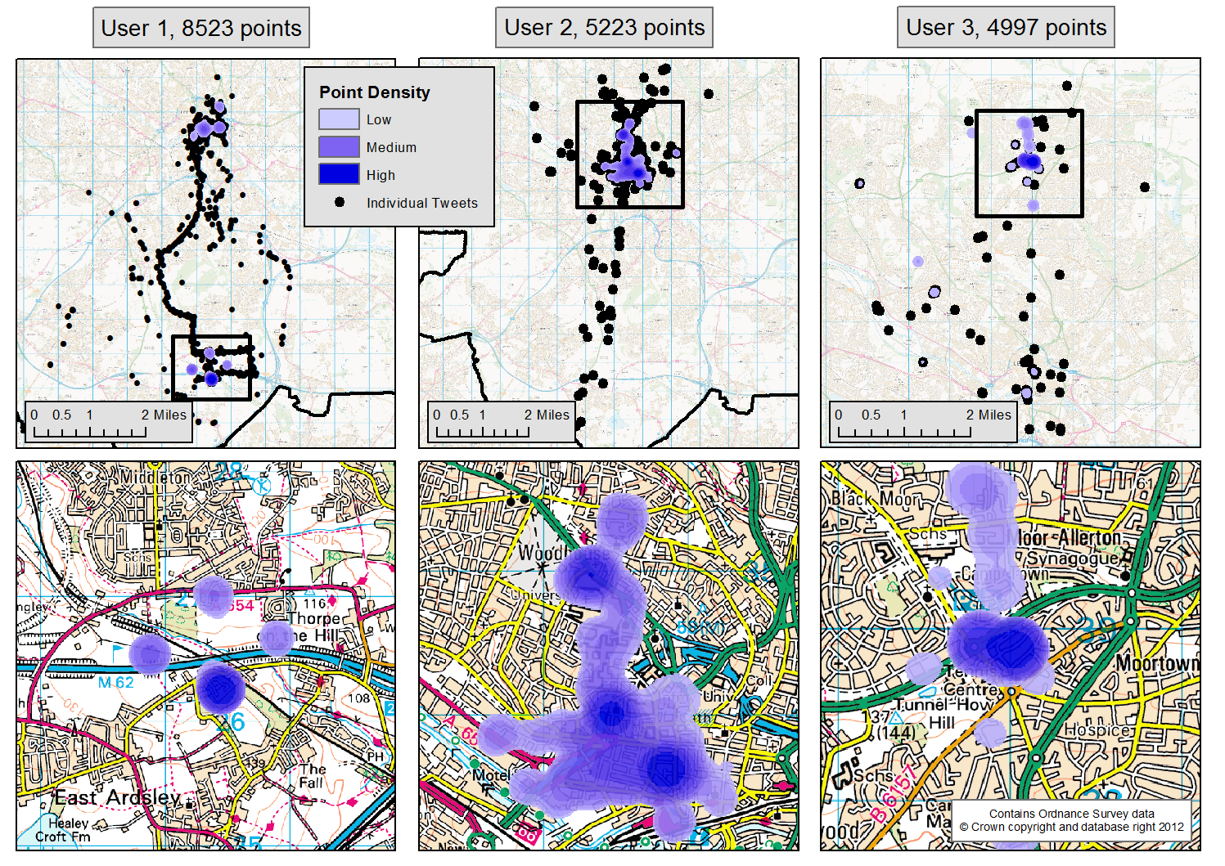
Analysis of Individual Behaviour – Anchor Points
Spatial analysis to identify the home locations of individual users
Some clear spatio-temporal behaviour (e.g. communting, socialising etc.).
Estimate ‘home’ and then calculate distance from home at different times
Journey to work?

Slide 14
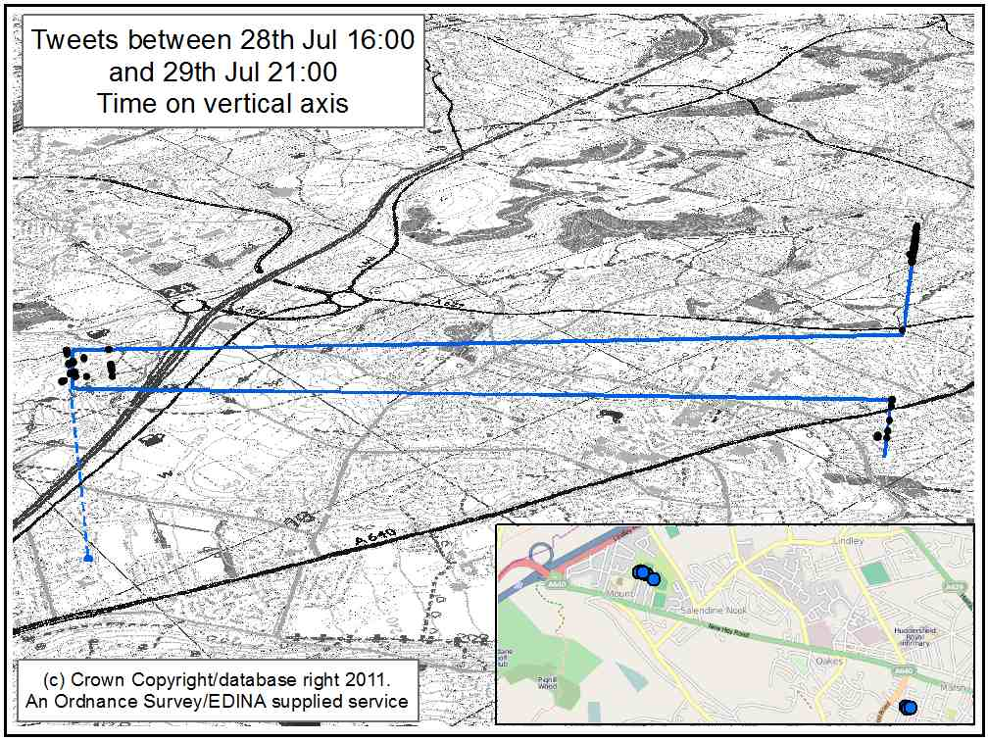

Spatio-Temporal Behaviour
More important than aggregate patterns, we can identify the behaviour of individual users
Estimate ‘home’ and then calculate distance at different times
Could estimate journey times, means of travel etc.
Very useful for calibration of an ABM

Slide 15
Activity Matrices (I)
Once the ‘home’ location has been estimated, it is possible to build a profile of each user’s average daily activity
The most common behaviour at a given time period takes precedence
User | 0 | 1 | 2 | 3 | 4 | 5 | 6 | 7 | 8 | 9 | 10 | 11 | 12 | 13 | 14 | 15 | 16 | 17 | 18 | 19 | 20 | 21 | 22 | 23
a | 3 | 0 | 0 | 0 | 0 | 0 | 0 | 0 | 0 | 0 | 0 | 3 | 0 | 0 | 3 | 0 | 3 | 3 | 3 | 3 | 3 | 3 | 3 | 3
b | 3 | 3 | 0 | 0 | 0 | 3 | 3 | 0 | 0 | 0 | 1 | 3 | 1 | 0 | 3 | 0 | 0 | 3 | 3 | 0 | 1 | 3 | 0 | 0
c | 1 | 3 | 0 | 0 | 0 | 0 | 0 | 0 | 1 | 1 | 0 | 1 | 0 | 1 | 0 | 1 | 1 | 1 | 1 | 1 | 1 | 1 | 1 | 1
d | 0 | 0 | 0 | 0 | 0 | 0 | 0 | 0 | 0 | 1 | 0 | 0 | 3 | 0 | 3 | 1 | 1 | 1 | 1 | 1 | 1 | 1 | 1 | 1
e | 0 | 0 | 0 | 0 | 0 | 0 | 0 | 0 | 0 | 0 | 0 | 0 | 0 | 0 | 0 | 0 | 0 | 0 | 0 | 0 | 0 | 0 | 0 | 0
f | 1 | 0 | 0 | 0 | 0 | 3 | 3 | 3 | 3 | 3 | 3 | 3 | 3 | 3 | 3 | 3 | 3 | 1 | 3 | 3 | 3 | 1 | 1 | 1
g | 0 | 0 | 0 | 0 | 0 | 0 | 0 | 0 | 3 | 3 | 0 | 0 | 1 | 3 | 0 | 0 | 0 | 0 | 3 | 3 | 3 | 0 | 3 | 0
h | 0 | 0 | 0 | 0 | 0 | 0 | 0 | 3 | 3 | 0 | 0 | 0 | 3 | 0 | 0 | 0 | 0 | 0 | 0 | 0 | 0 | 0 | 0 | 0
i | 0 | 0 | 0 | 0 | 0 | 0 | 0 | 0 | 0 | 0 | 0 | 0 | 0 | 0 | 0 | 1 | 1 | 1 | 0 | 0 | 0 | 0 | 0 | 0
‘Raw’ behavioural profiles
Interpolating to remove no-data
At Home
Away from Home
No Data
User | 0 | 1 | 2 | 3 | 4 | 5 | 6 | 7 | 8 | 9 | 10 | 11 | 12 | 13 | 14 | 15 | 16 | 17 | 18 | 19 | 20 | 21 | 22 | 23
a | 3 | 3 | 3 | 3 | 3 | 3 | 3 | 3 | 3 | 3 | 3 | 3 | 3 | 3 | 3 | 3 | 3 | 3 | 3 | 3 | 3 | 3 | 3 | 3
b | 3 | 3 | 3 | 3 | 3 | 3 | 3 | 3 | 3 | 1 | 1 | 3 | 1 | 3 | 3 | 3 | 3 | 3 | 3 | 3 | 1 | 3 | 1 | 1
c | 1 | 3 | 3 | 3 | 3 | 1 | 1 | 1 | 1 | 1 | 1 | 1 | 1 | 1 | 1 | 1 | 1 | 1 | 1 | 1 | 1 | 1 | 1 | 1
d | 1 | 1 | 1 | 1 | 1 | 1 | 1 | 1 | 1 | 1 | 1 | 3 | 3 | 3 | 3 | 1 | 1 | 1 | 1 | 1 | 1 | 1 | 1 | 1
e | 1 | 1 | 1 | 1 | 1 | 1 | 1 | 3 | 3 | 3 | 3 | 3 | 3 | 3 | 3 | 3 | 3 | 3 | 1 | 1 | 1 | 1 | 1 | 1
f | 1 | 1 | 1 | 3 | 3 | 3 | 3 | 3 | 3 | 3 | 3 | 3 | 3 | 3 | 3 | 3 | 3 | 1 | 3 | 3 | 3 | 1 | 1 | 1
g | 3 | 3 | 3 | 3 | 3 | 3 | 3 | 3 | 3 | 3 | 3 | 1 | 1 | 3 | 3 | 3 | 3 | 3 | 3 | 3 | 3 | 3 | 3 | 3
h | 1 | 1 | 1 | 1 | 3 | 3 | 3 | 3 | 3 | 3 | 3 | 3 | 3 | 3 | 3 | 3 | 3 | 3 | 1 | 1 | 1 | 1 | 1 | 1
i | 1 | 1 | 1 | 1 | 1 | 1 | 1 | 3 | 3 | 3 | 3 | 3 | 3 | 3 | 3 | 1 | 1 | 1 | 1 | 1 | 1 | 1 | 1 | 1

Slide 16
Activity Matrices (II)
Overall, activity matrices appear reasonably realistic
Peak in away from home at ~2pm
Peak in at home activity at ~10pm.
Next stages:
Develop a more intelligent interpolation algorithm (borrow from GIS?)
Spatio-temporal text mining routines to use textual content to improve behaviour classification

Slide 17
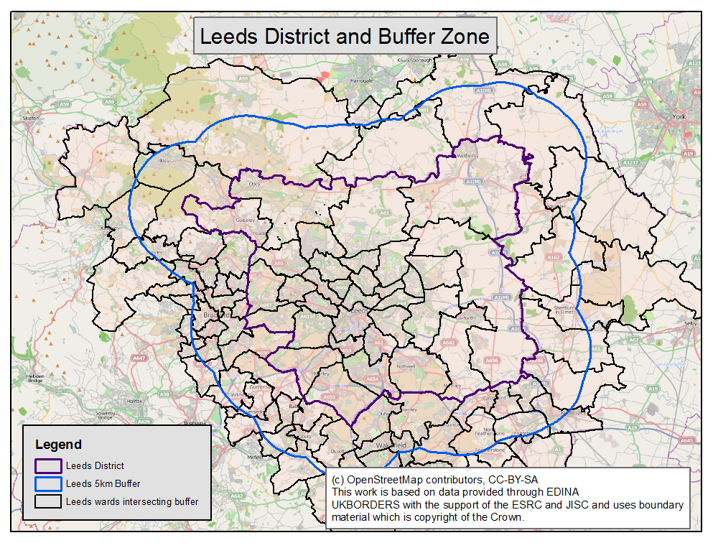
Towards A Model of Urban Dynamics (I) Microsimulation
Simulation are: Leeds and a buffer zone
Microsimulation to synthesise individual-level population
~80M people in Leeds
2.08M in simulation area
Iterative Reweighting
Useful attributes (employment, age, etc.)
Data: UK Census
Small Area Statistics
Sample of Anonymised Records

Slide 18
Towards A Model of Urban Dynamics (II) Commuting
Estimate where people go to work from the census
Model parameters determine when people go to work and for how long.
Sample from a normal distribution
Parameters can vary across region
Parameter
μ₁ | Mean time to leave for work (e.g. 8am)
σ²₁ | Standard deviation (e.g. 1hr)
μ₂ | Mean time to stay at work (e.g. 8 hours)
σ²₂ | Standard deviation (e.g. 2hr)

Slide 19
Towards A Model of Urban Dynamics (II) Calibration
Calibrate these parameters to data from Twitter (e.g. ‘activity matrices’)
Large parameter space
4 * NumRegions
Use (e.g.) a genetic algorithm

Slide 20
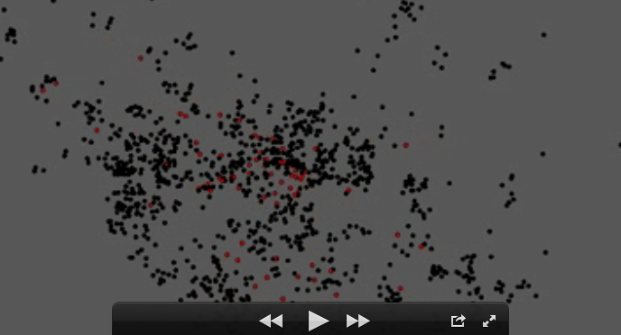
Prototype Model

Slide 21
Videos..
A video of the prototype model running is available online:
http://youtu.be/wTw_Sv6aaz0

Slide 22
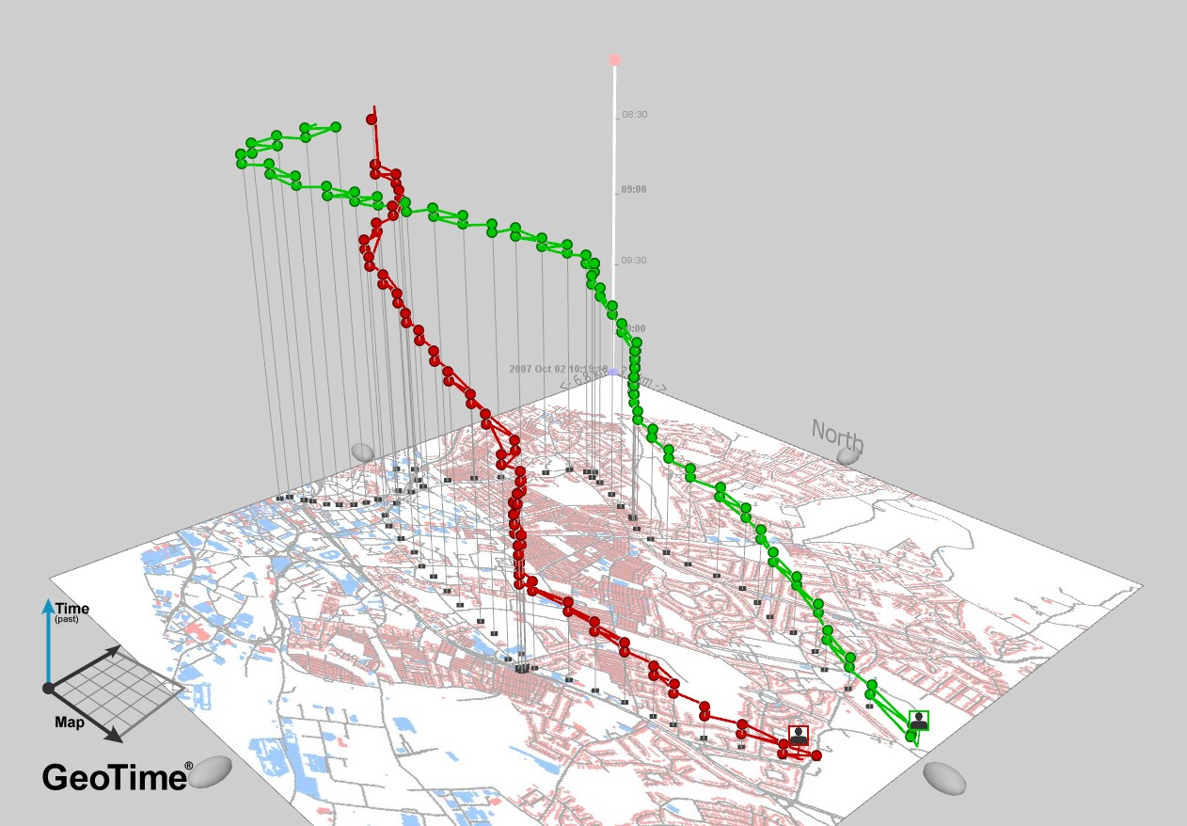
Computational Challenges
Handling millions of agents…
Memory
Runtime
Especially in a GA!
History of actions
Managing data
Spatial analysis
GIS don’t like millions of records
E.g. hours to do a simple data calculation
Storage (2Gb+ database of tweets)
Simple analysis become difficult
Too much data for Excel

Slide 23
Data and Ethical Challenges
Data bias:
Sampling
1% sample (from twitter)
<10% sample (from GPS)
Who’s missing?
Enormous skew
Large quantity generated by small proportion of users
Similar problems with other data (e.g. rail travel smart cards, Oyster)
Some solutions?
Geodemographics
Linking to other individual-level data sets?
Ethics

Slide 24
Conclusions
Aim: develop a model of urban-dynamics, calibrated using novel crowd-sourced data.
New “crowd-sourced” data can help to improve social models (?)
Possibly insurmountable problems with bias, but methods potentially useful in the future
Particularly in terms of how to manage the data/computations
Improved identification of behaviour
New ways to handle computational complexity
In situ model calibration

Slide 25
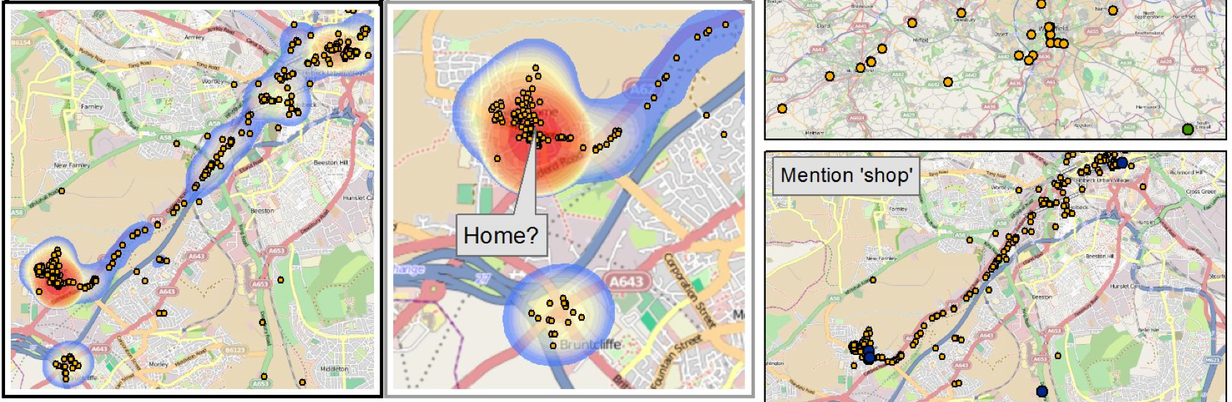
Thank you
Nick Malleson & Mark Birkin, School of Geography, University of Leeds
http://www.geog.leeds.ac.uk/people/n.malleson
http://nickmalleson.co.uk/

